Slide 1


PSYCHOLOGY
Chapter 14 STRESS, LIFESTYLE, AND HEALTH
PowerPoint Image Slideshow

Slide 2

STRESS
This chapter explores our current understanding of stress, including:
Psychological and physiological natures.
Causes and consequences.
Stress management techniques.
Figure 14.1 (credit “left”: modification of work by Travis K. Mendoza; credit “center”: modification of work by “albertogp123”/Flickr; credit “right”: modification of work by Jeffrey Pioquinto, SJ)

Slide 3
WHAT IS STRESS?
GOOD STRESS?
THE PREVALENCE OF STRESS
STRESS AMONG DEMOGRAPHIC GROUPS
WALTER CANNON: FIGHT OR FLIGHT REPONSE
HANS SELYE: GENERAL ADAPTATION SYNDROME
THE PHYSIOLOGICAL BASIS OF STRESS

Slide 4
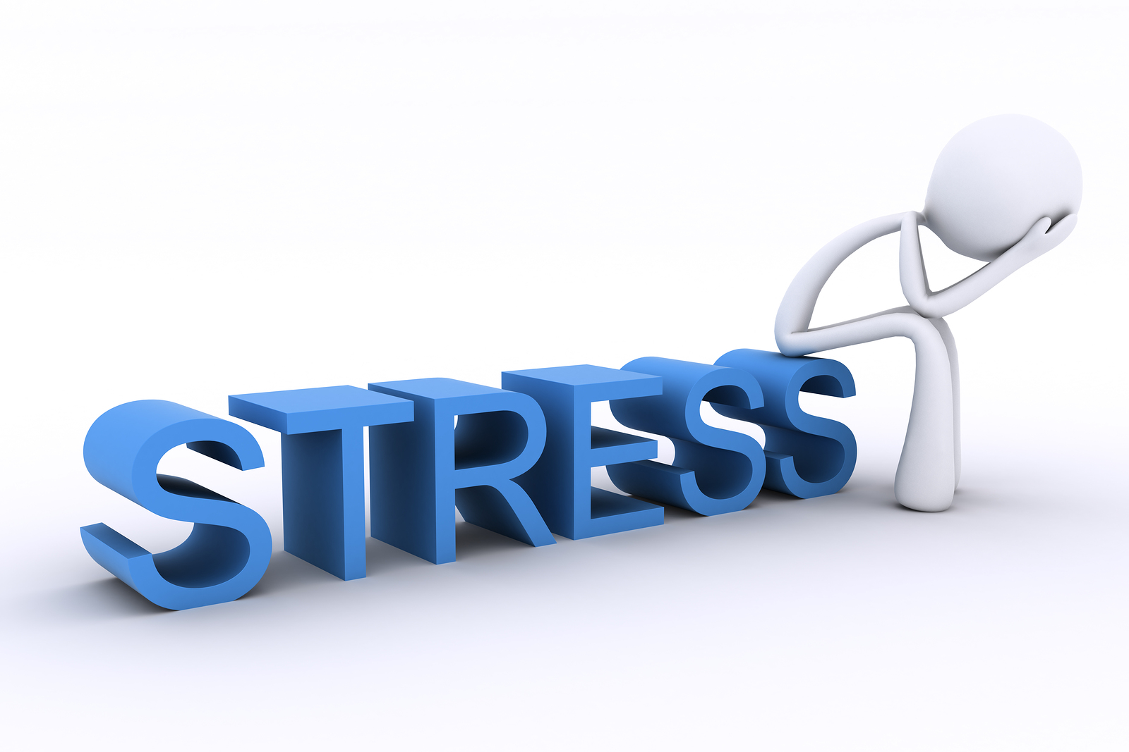
WHAT IS STRESS?
Stress is a term used loosely to describe a variety of unpleasant feeling states (e.g., frustrated, angry, conflicted, overwhelmed, or fatigued).
Stimulus-based definitions: stress is a demanding or threatening event/situation (e.g., high-stress job).
Characterizes stress as a stimulus that causes certain reactions.
Fails to recognize that people differ in how they view and react to challenging situations.
Response-based definitions: emphasize physiological responses that occur in response to demanding or threatening situations.
Characterizes stress as a response to environmental conditions.
Neither provide a complete definition of stress.
(Credit: Morty Lefkoe)

Slide 5
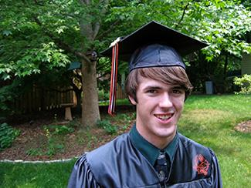
COGNITIVE APPRAISALS
Stress – a process whereby an individual perceives and responds to events he appraises as overwhelming or threatening to his well-being.
This definition places importance on how we appraise (judge) demanding/threatening events (stressors) which then influence our reaction.
Primary appraisal – judgement about the degree of potential harm/threat to well-being that a stressor might entail.
Threat – stressor that could lead to harm/loss/negative consequences.
Challenge – stressor that carries the potential for gain/personal growth.
E.g. Graduating from college and entering the workforce can be viewed as either a threat (loss of financial support) or a challenge (opportunity for independence and growth).
Secondary appraisal – judgement of the options available to cope with a stressor, and perceptions of how effective such options will be.
A threat is less stressful if we believe something can be done about it.
Figure 14.2 (credit: Timothy Zanker)

Slide 6
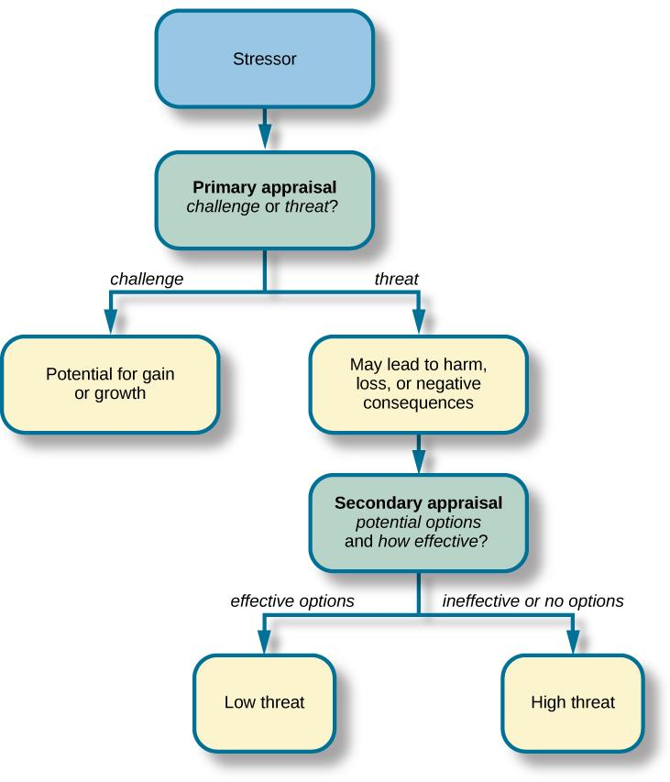
COGNITIVE APPRAISALS
Stress is likely to result if a stressor is perceived as extremely threatening or threatening with few or no effective coping options available.
Figure 14.3

Slide 7
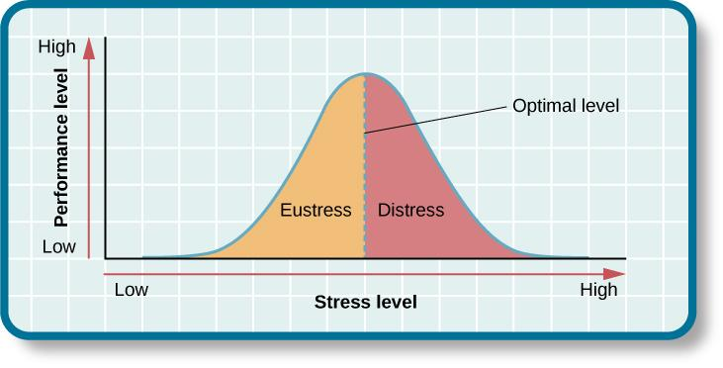
GOOD STRESS?
Eustress - Stress that can be positive and motivate us to do things in our best interests.
Associated with positive feelings, optimal health, and performance.
Distress - ”Bad” stress, causing people to feel burned out, (fatigued and exhausted), and performance to decline.
Figure 14.4
As the stress level increases from low to moderate, so does performance. At the optimal level (the peak of the curve), performance has reached its peak. If stress exceeds the optimal level, it will reach the distress region, where it will become excessive and debilitating, and performance will decline (Everly & Lating, 2002).

Slide 8
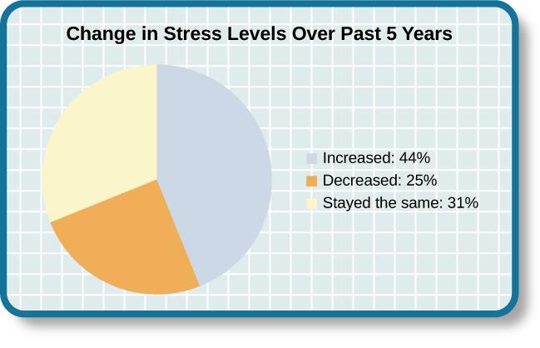
THE PREVALENCE OF STRESS
Stress is everywhere and plays a role in all of our lives to some extent.
Stress can evoke a variety of responses including:
Physiological – accelerated heart rate, headaches, or gastrointestinal problems.
Cognitive – difficulty concentrating or making decisions.
Behavioral – drinking alcohol, smoking, or taking actions directed at eliminating the cause of stress.
Nearly half of U.S. adults indicated that their stress levels have increased over the last five years (Neelakantan, 2013).
Figure 14.5

Slide 9
HEALTH PSYCHOLOGY
Health psychology is a subfield devoted to understanding the importance of psychological influences on health, illness, and how people respond when they become ill. It investigates:
The connection between stress and illness.
Why people make certain life choices.
The effectiveness of interventions aimed at changing unhealthy behaviors.
Which groups of people are especially at risk for negative health outcomes, based on psychological or behavioral factors.
Stress Among Demographic Groups
National surveys found:
Higher stress in women than in men.
Higher levels of stress in those that were unemployed, had less education, and less income.
Retired persons reported lowest levels of stress.
2006-2009:
Greatest increase in stress levels occurred among men, Whites, people aged 45-64, college graduates, and those with full-time employment.
Change potentially due to the 2008-2009 economic turndown.

Slide 10
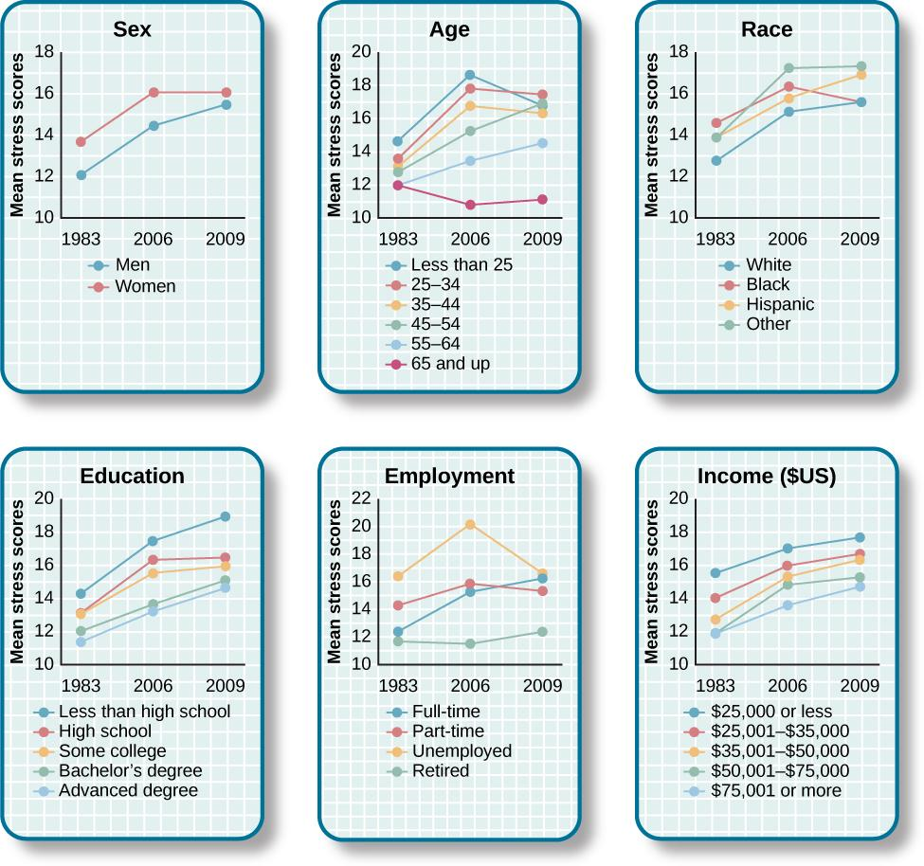
STRESS AMONG DEMOGRAPHIC GROUPS
Figure 14.6
The charts above, adapted from Cohen & Janicki-Deverts (2012), depict the mean stress level scores among different demographic groups during the years 1983, 2006, and 2009. Stress levels generally show a marked increase over this quarter-century time span.

Slide 11
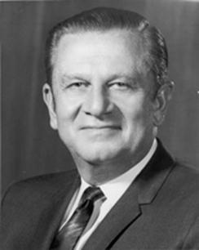
EARLY CONTRIBUTIONS TO THE STUDY
OF STRESS
Walter Cannon (Early 20th Century)
First to identify the body’s physiological reactions to stress.
First articulated and named the fight-or-flight response, which he suggested is a built-in mechanism that stabilizes physiological variables at levels optimal for survival.
Fight-or-flight response – set of physiological reactions that occur when an individual encounters a perceived threat; produced by activation of the sympathetic nervous system and the endocrine system.
This arousal prepares a person to either fight or flee from a perceived threat.
An adaptive response, helpful in species survival.
Figure 14.7

Slide 12
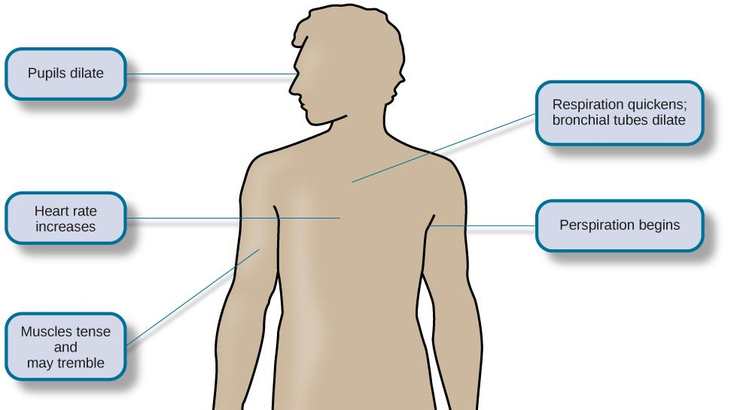
FIGHT OR FLIGHT RESPONSE
In response to a threatening stressor, the adrenal glands release epinephrine (adrenaline) and norepinephrine (noradrenaline) which causes physiological changes in the body, as shown below.
Figure 14.8

Slide 13
GENERAL ADAPTATION SYNDROME
HANS SELYE
Hans Selye specialized in research about stress.
Noticed that prolonged exposure to stressors caused rats to show signs of adrenal enlargement, thymus and lymph node shrinkage, and stomach ulceration.
The same pattern of physiological reactions occurred regardless of the stressor.
Selye had discovered the general adaptation syndrome.
  The body’s nonspecific physiological response to stress.
3 Stages:
Alarm Reaction – the body’s immediate reaction upon facing a threatening situation or emergency.
Physiological reactions that provide energy to manage the situation.
Stage of Resistance – The body has adapted (readjusted) to the stressor but remains alert and prepared to respond (with less intensity).
Physiological reactions diminish.
Stage of Exhaustion – Person can no longer adapt to the stressor (depletion of physical resources). Physical wear takes its toll on the body’s tissues and organs.
May result in illness, disease, or death.

Slide 14
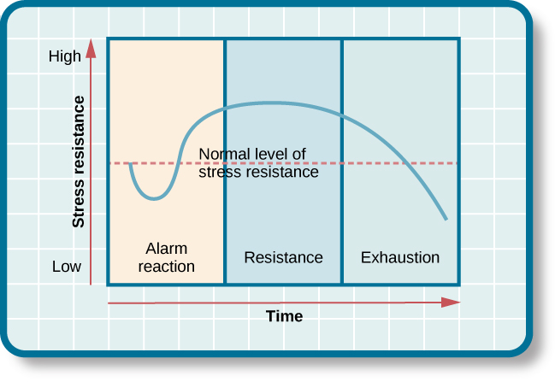
GENERAL ADAPTATION SYNDROME
The three stages of Selye’s general adaptation syndrome are shown in this graph. Prolonged stress ultimately results in exhaustion.
Figure 14.10

Slide 15
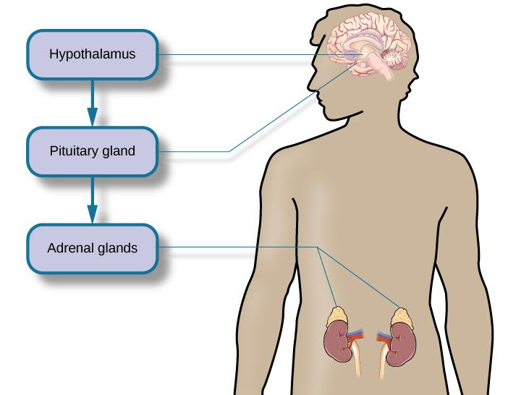
THE PHYSIOLOGICAL BASIS OF STRESS
Sympathetic nervous system - Triggers arousal in response to a stressor via the release of adrenaline from the adrenal glands.
Hypothalamic-pituitary-adrenal (HPA) axis
Stress → hypothalamus releases corticotrophin-releasing factor (hormone) → pituitary gland releases ACTH → ACTH activates adrenal glands → adrenal glands release hormones including cortisol.
Cortisol – a stress hormone that helps provide a boost of energy when we first encounter a stressor, preparing us to flight or flee.
  Continuous elevated levels of cortisol (chronic stress) weaken the immune system.
In moments of stress, this process can provide energy, improve immune system functioning temporarily, and decrease pain sensitivity.
Figure 14.11

Slide 16
STRESSORS
TRAUMATIC EVENTS
LIFE CHANGES
HASSLES
OTHER STRESSORS

Slide 17
STRESSORS
Chronic stressors – events that persist over an extended period of time (e.g., long term unemployment).
Acute stressors – brief events that sometimes continue to be experienced as overwhelming well after the even has ended (e.g., falling and breaking a leg).
TRAUMATIC EVENTS
One category of stressors are traumatic events: situations involving exposure to actual or threatened death or serious injury.
Exposure to military combat.
Threatened/actual physical assaults – physical attacks, sexual assault, childhood abuse, robbery etc.
Terrorist attacks.
Natural disasters.
Car accidents.
Stressors of this type can cause people to develop post-traumatic stress disorder (PTSD): a chronic stress reaction including intrusive and painful memories, jumpiness and persistent negative emotional states among other symptoms.

Slide 18
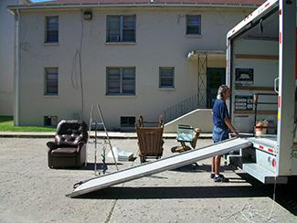
LIFE CHANGES
Some fairly typical life events, such as moving, can be significant stressors. Even when the move is intentional and positive, the amount of resulting change in daily life can cause stress.
Holmes and Rahe (1960s)
Hypothesized that life events requiring significant change are stressful, whether they are desirable or undesirable.
Social Readjustment Rating Scale (SRRS):
Figure 14.12 (credit: "Jellaluna"/Flickr)
A scale consisting of 43 life events that require varying degrees of personal readjustment.
Developed by asking 394 participants to provide a numerical estimate corresponding to how much readjustment they felt each event would require.
Each life event has a score/life change unit (LCU) from 11 to 100, representing the perceived magnitude of life change they involve.
Death of a spouse was ranked highest (100), and divorce was ranked second highest (73).
Research demonstrates that accumulating a high number of LCUs within a brief time period is related to a range of physical illnesses/symptoms and mental health problems.
Used to assess amount of stress in people’s lives.

Slide 19
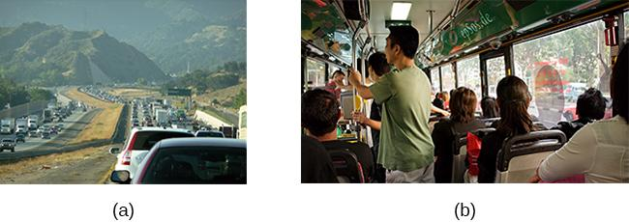
HASSLES
Daily hassles – minor irritations and annoyances that are part of our every day lives.
Often lead to negative and distressed mood states.
Can build up and leave us feeling stressed.
Frequency of daily hassles is a better predictor of physical and psychological heath that life change units.
E.g. daily commutes, whether (a) on the road or (b) via public transportation, can be hassles that contribute to our feelings of everyday stress.
Figure 14.13 (credit a: modification of work by Jeff Turner; credit b: modification of work by "epSos.de"/Flickr)

Slide 20
OTHER STRESSORS
High Stress Occupations
Difficult, demanding, or unsafe working conditions.
Occupations containing unpleasant elements – exposure to loud noise, harassment, threats of physical violence, constant frustration.
Job strain – work situation that combines excessive job demands and workload with little discretion in decision making or job control.
Associated with increased risk of physical problems..
Job burnout – a general sense of emotional exhaustion and cynicism in relation to one’s job.
Occurs frequently among people in human service jobs (e.g., social workers, teachers, police officers).
Close Relationships
Relationships with friends and family can be a source of stress.
Negative aspects that can cause stress include:
Adverse exchanges and conflicts.
Lack of emotional support or confiding.
Lack of reciprocity.

Slide 21
STRESS AND ILLNESS
PSYCHOPHYSIOLOGICAL DISORDERS
STRESS & THE IMMUNE SYSTEM
CARDIOVASCULAR DISORDERS
PERSONALITY TYPES
DEPRESSION & THE HEART
ASTHMA
TENSION HEADACHES

Slide 22
PSYCHOPHYSIOLOGICAL DISORDERS
Chronic stress and its sustained physiological reactions can lead to wear and tear on the body.
Sustained high blood pressure can lead to a heart attack or heart failure.
Continuous exposure to cortisol can weaken the immune system putting a person at risk for infection or disease.
Psychophysiological disorders – physical disorders/diseases whose symptoms are brought about or worsened by stress and emotional factors.
Common examples include:
Tension headaches.
Asthma.
Acne.
Eczema.
Hypertension.
Irritable bowl syndrome.
Coronary heart disease.

Slide 23
STRESS & THE IMMUNE SYSTEM
Immune System Errors
Autoimmune disease – immune system mistakes the body’s own healthy cells for invaders and repeatedly attacks them (can affect almost any part of the body).
Immunosuppression – the decreased effectiveness of the immune system.
Causes people to become susceptible to infections, illness, and disease.
Stressors and Immune Function
Psychoneuroimmunology – field that studies how psychological factors influence the immune system and immune functioning.
Studies have shown that the immune system can be classically conditioned leading to the idea that if classical conditioning can alter immunity then so can other psychological factors.
Many kinds of stressors are associated with poor/weakened immune functioning.
How does stress weaken the immune system?
One way that the immune system is weakened is through the hormones released during stress. These hormones inhibit the production of lymphocytes (white blood cells important in the immune response).

Slide 24
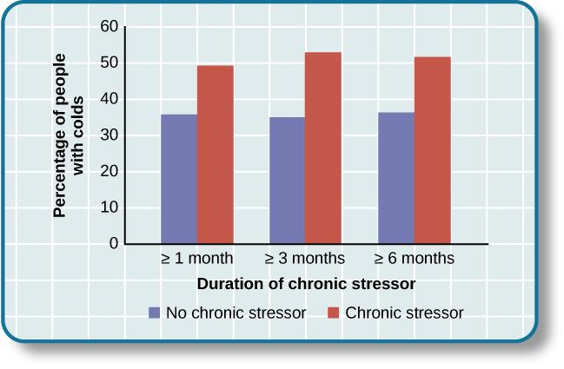
STUDY ON STRESS & IMMUNE FUNCTION
COHEN (1998)
276 healthy volunteers were interviewed about recent stressful experiences.
After the interview, they were given nasal drops containing the cold virus.
This graph shows the percentages of participants who developed colds (after receiving the cold virus) after reporting having experienced chronic stressors lasting at least one month, three months, and six months (adapted from Cohen et al., 1998).
Participants who reported experiencing chronic stressors for more than one month were more likely to develop colds than those who reported no chronic stressors.
Figure 14.15

Slide 25
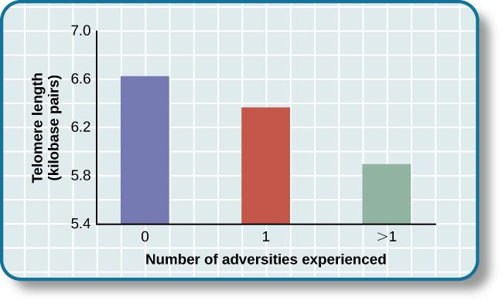
STRESS & AGING
Research suggests that stress can shorten telomeres (segments of DNA that protect the ends of chromosomes).
Shortened telomeres can inhibit/block cell division, which includes growth and proliferation of new cells, leading to more rapid aging.
This graph shows that telomeres are shorter in adults who experienced more trauma as children (adapted from Blackburn & Epel, 2012).
Figure 14.16

Slide 26
CARDIOVASCULAR DISORDERS
The cardiovascular system plays a central role in the stress response making it a key focus in studies of psychophysiological disorders.
Heart disease – a cardiovascular disorder.
A major risk factor for heart disease is hypertension.
Hypertension – high blood pressure.
Can be caused by stressors including job strain, marital conflict, and natural disasters.
Forces the heart to pump harder, thus putting increased physical strain on the heart.
Has no symptoms.
Can lead to a heart attack, stroke, or heart failure, as well as kidney failure and blindness.
Both heart disease and hypertension have also been linked to negative affectivity.
Negative affectivity – tendency to experience distressed emotional states involving anger, contempt, disgust, guilt, fear, and nervousness.

Slide 27
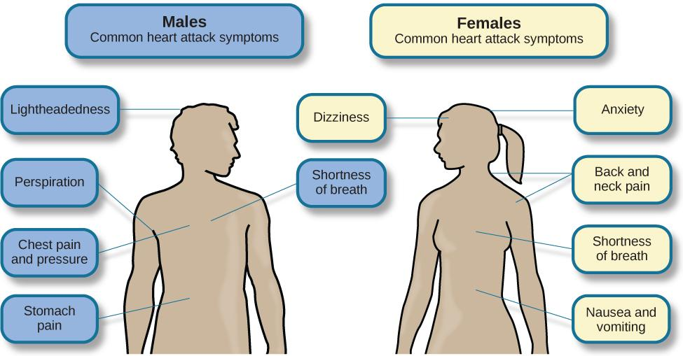
HEART ATTACK SYMPTOMS
Figure 14.17
Males and females often experience different symptoms of a heart attack.

Slide 28
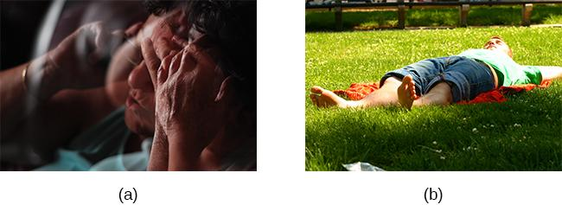
TYPE A & B PERSONALITIES
Friedman and Rosenman (1974):
Discovered that people who are prone to heart disease tend to think, feel, and act differently than those who are not.
Found that heart disease is over seven times more frequent among Type As.
Type A – tend to be extremely competitive, intensely driven, impatient, rushed, and hostile toward others.
Type B – tend to be relaxed and laid back.
Further research suggested that the one of the most important factors in the development of heart disease is the anger/hostility dimension of Type A behavior pattern.
Individuals that indicated they responded to pressure with anger were over 6 times more likely than those who indicated less anger to have had a heart attack by age 55.
Figure 14.18 (credit a: modification of work by Greg Hernandez; credit b: modification of work by Elvert Barnes)

Slide 29
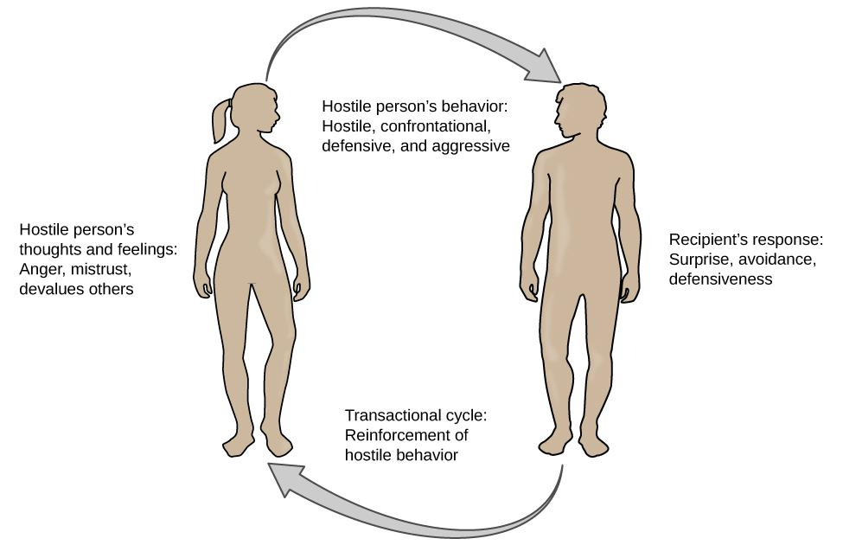
TRANSACTIONAL MODEL OF HOSTILITY
FOR PREDICTING SOCIAL INTERACTIONS
Anger and hostility appear to constitute long-term risk factors for adverse cardiovascular outcomes.
Why?
According to the transactional model of hostility for predicting social interactions (Vella et al., 2012), the thoughts and feelings of a hostile person promote antagonistic behavior toward others, which in turn reinforces complimentary reactions from others, thereby intensifying ones’ hostile disposition and intensifying the cyclical nature of this relationship.
Figure 14.19

Slide 30
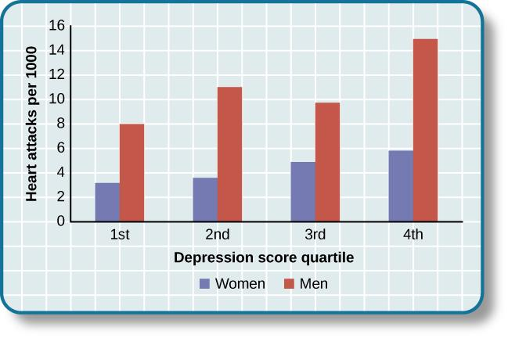
DEPRESSION & THE HEART
Research suggests that a relationship exists between depression and heart disease.
One reason for this seems to be that people diagnosed with depression as children have been found to be more likely to be obese, smoke, and physically inactive.
Depression may increase the likelihood of living an unhealthy lifestyle and therefore the chances of heart disease.
This graph shows the incidence of heart attacks among men and women by depression score quartile (adapted from Barefoot & Schroll, 1996).
Figure 14.20

Slide 31
ASTHMA
Asthma – chronic disease in which the airways become inflamed and narrowed, leading to difficulty breathing.
Psychological factors play an important role in asthma.
Studies show that some people with asthma will experience asthma-like symptoms if they expect to experience symptoms.
People with asthma report and display a high level of negative emotions (e.g., anxiety).
Asthma attacks have been linked to periods of high emotionality.
Exposure to stressful experiences has been linked to the development of asthma throughout the lifespan.

Slide 32
REGULATION OF STRESS
COPING STYLES
CONTROL & STRESS
SOCIAL SUPPORT
STRESS REDUCTION TECHNIQUES

Slide 33
COPING STYLES
Lazarus and Folkman (1984)
Problem-focused coping – individual attempts to manage or alter the problem that is causing them to experience stress.
Involves identifying the problem, considering possible solutions, weight the costs and benefits of these solutions, and then selecting an alternative.
Proactively addresses the problem.
More likely to be used when the stressor is perceived as controllable.
Emotion-focused coping – efforts to change or reduce the negative emotions associated with stress.
Can include avoiding, minimizing, or distancing oneself from the problem, or positive comparisons with others, or seeking something positive in a negative event.
Treats the symptoms of stress, not the cause.
More often used for stressors we feel powerless to change.
E.g. You are stressed because you are failing a class.
Problem-focused approach – study more, contact professor for help, find a tutor.
Emotion-focused approach – watch a movie or play games to distract yourself from the problem.

Slide 34
CONTROL & STRESS
The ability to enact control in our lives is a basic tenet of human behavior.
Our reaction to potential stressors depends largely on how much control we feel we have.
Perceived control – our beliefs about our personal capacity to exert influence over and shape outcomes.
Has major implications for health and happiness.
Greater personal control is associated with:
Better physical and mental health.
Greater psychological well-being.
Lower reactivity to stressors in daily life.

Slide 35
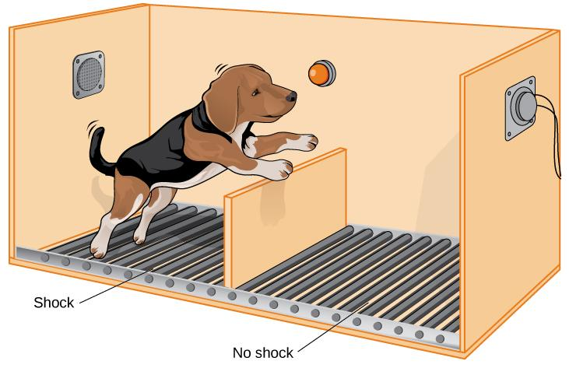
LEARNED HELPLESSNESS
MARTIN SELIGMAN (1967)
Learned helplessness – an acquired belief that one is powerless to do anything about a situation.
In Seligman’s experiment, dogs were placed in a chamber where they received electric shocks from which they could not escape.
When they were later given the opportunity to escape the shocks, most seemed to give up and did not even try. They had acquired learned helplessness.
Seligman believed learned helplessness to be a possible cause of depression.
Figure 14.22

Slide 36
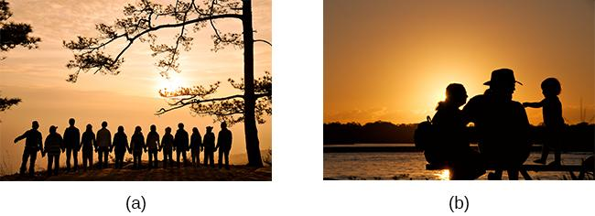
SOCIAL SUPPORT
A fundamental human motive is the need to form and maintain strong, stable relationships.
Social support - the soothing impact of friends, family, and acquaintances.
Can include advice, guidance, encouragement, acceptance, emotional comfort, and tangible assistance.
Provides comfort when faced with life stressors.
A psychosocial factor affecting health outcomes – individuals with stronger social relationships have a 50% greater likelihood of survival compared to those with weal social relationships.
Research suggests social support boosts the immune system and reduces blood pressure.
Figure 14.23 (credit a: modification of work by Nattachai Noogure; credit b: modification of work by Christian Haugen)

Slide 37
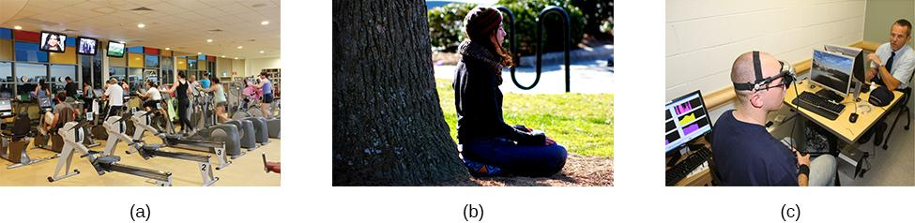
STRESS REDUCTION TECHNIQUES
Stress reduction techniques may include:
Exercise – reduces stress and increases resistance to adverse effects of stress.
Meditation and relaxation
Relaxation response techniques – reduces sympathetic arousal, reduces blood pressure.
Biofeedback – uses electronic equipment to measure a person’s involuntary (neuromuscular and autonomic) activity and provide feedback to help the person gain a level of voluntary control over these processes.
Figure 14.24 (credit a: modification of work by “UNE Photos”/Flickr; credit b: modification of work by Caleb Roenigk; credit c: modification of work by Dr. Carmen Russoniello).

Slide 38
THE PURSUIT OF HAPPINESS
HAPPINESS
POSITIVE PSYCHOLOGY
FLOW

Slide 39
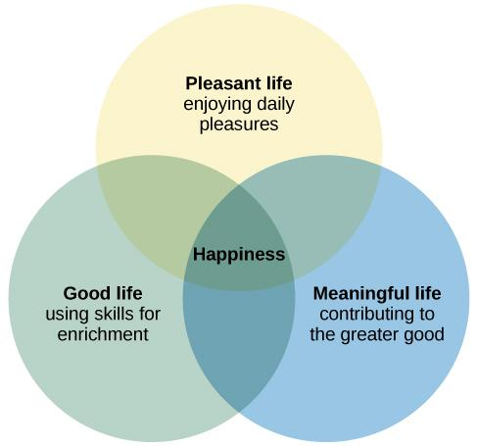
ELEMENTS OF HAPPINESS
Happiness is an enduring state of subjective well-being consisting of joy, contentment, and other positive emotions, plus the sense that one’s life has meaning and value.
Figure 14.25

Slide 40
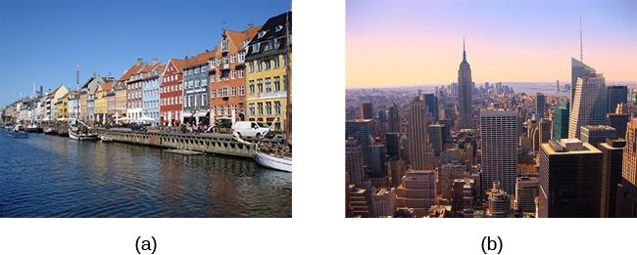
HOW HAPPY ARE PEOPLE IN GENERAL?
The average person in the world tends to be relatively happy.
Surveys of residents in over 150 countries indicate that Denmark has the happiest citizens in the world.
Americans ranked the United States as the 17th happiest country in which to live.
Figure 14.26 (credit a: modification of work by "JamesZ_Flickr"/Flickr; credit b: modification of work by Ryan Swindell)

Slide 41
FACTORS CONNECTED TO HAPPINESS
What factors influence happiness?
Age
  Life satisfaction usually increases with age.
Family and social relationships
  Married people report being happier than those that are not.
  High-quality social relationships and strong social support networks correlate with increased happiness.
Money
  A nations gross domestic product (GDP) is associated with happiness levels.
  Wealthy individuals tend to be happier than poor individuals.
  Happiness increases with income only up to $75,000.
Religion
  In nations with difficult living conditions, religiosity is associated with greater well-being but does not make a difference in nations with favorable living conditions.
Culture
  People that possess characteristics values in their culture tend to be happier.

Slide 42
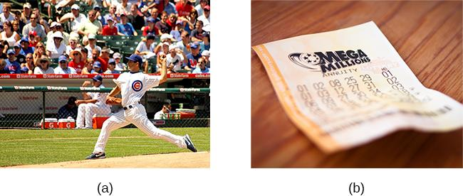
LIFE EVENTS & HAPPINESS
People are often poor at predicting the intensity and duration of their future emotions.
Events might initially cause an intense surge of emotion but we eventually adapt to changing emotional circumstances in our lives.
Dramatic life events have much less long-lasting impact on happiness than might be expected.
Long-suffering Chicago Cub fans would no doubt feel elated if their team won a World Series championship.
In ways that are similar, those who play the lottery rightfully think that choosing the correct numbers and winning millions would lead to a surge in happiness. However, the initial burst of elation following such elusive events would most likely erode with time.
Figure 14.27 (credit a: modification of work by Phil Roeder; credit b: modification of work by Robert S. Donovan)

Slide 43
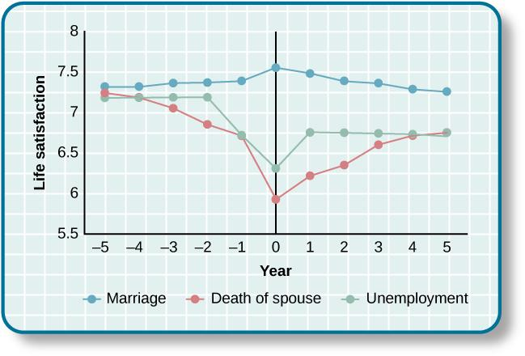
LIFE EVENTS & HAPPINESS
This graphs shows life satisfaction scores several years before and after three significant life events (0 represents the year the event happened) (Diener et al., 2006).
Despite the idea that life events do not permanently alter people’s general levels of happiness, these findings suggest that long-term happiness levels can and do change for some people.
Figure 14.28

Slide 44
POSITIVE PSYCHOLOGY
Seligman (1998) – urged psychologists to focus more on understanding how to build human strength and psychological well-being.
Positive psychology – seeks to identify and promote those qualities that lead to greater fulfillment in our lives.
Well-being
Satisfaction
Hope and optimism
Happiness
Capacity for love
Courage
Interpersonal skill
Aesthetic sensibility
Perseverance
Forgiveness and compassion
Originality
Future mindedness
Spirituality
High talent
Wisdom
Creativity
Altruism and empathy
Positive emotions
Enhancement of immune system functioning

Slide 45
POSITIVE EFFECT & OPTIMISM
Qualities that help promote psychological well-being are linked with many favorable health outcomes.
Positive Affect – pleasurable engagement with the environment, such as happiness, joy, enthusiasm, alertness, and excitement.
Associated with:
Greater social connectedness.
Emotional and practical support.
Adaptive coping efforts.
Lower depression
Longevity and favorable physiological functioning.
Optimism – the general tendency to look on the bright side of things.
Tendency to expect that good things will happen.
Tendency to view life’s stressors and difficulties as temporary and external to oneself.
Significant predictor of positive health outcomes.

Slide 46
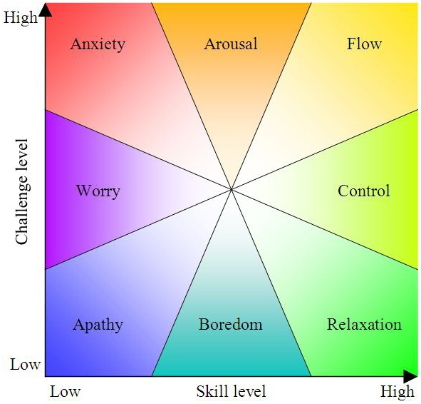
FLOW
Flow – a particular experience that is so engaging and engrossing that is becomes worth doing for its own sake.
Feeling of losing oneself in an activity.
State of effortless concentration and focus.
Feels like time passes more quickly than usual.
Usually related to creative endeavors and leisure activities.
Experienced by people who like their job or students who love studying.
Typically occurs when people engage in challenging activities that require skills and knowledge they know they possess.
Thought to play a key role in happiness.
(Credit: Mountaineer News Service)

